Slide 1
Exporting Snap 9 Data to Excel
MKTG2341 PC Lab9

Slide 2
Today’s Agenda
Part 1: Exporting SNAP data to XLDA
Part 2: Data Analysis in XLDA
Calculate Sample Size
Single Response Questions
Categorical Data
Metric Data
Grid Rating Questions
Compare Means (Metric Data)
Summarize Single Response (~ Categorical Data)
Multiple Response Questions

Slide 3
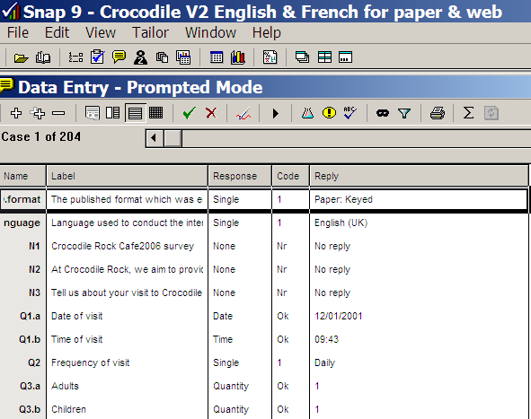
Exporting Snap Data to CSV
Open Snap 9.
Open your file.
Today we will use Crocodile survey.
Click Data Entry

Slide 4
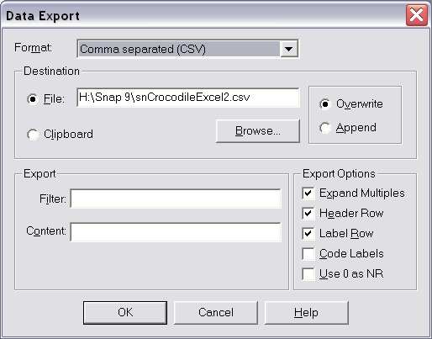
Exporting Snap Data to CSV
Click File | Export
Comma Separated (CSV)
Click File
Browse to find Personal files (H\: )
Note: the File | Export function will export different files depending on the mode you are in.
For this exercise we are in the DATA mode to export to CSV.
If you are in the QUESTIONNAIRE mode you will export the questions to text file (but the data will not be exported).

Slide 5
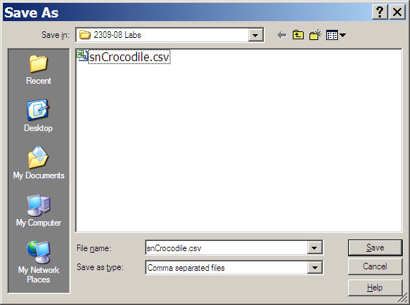
Exporting Snap Data to CSV
Click Browse, a new box dialog opens displaying only .csv files.
Specify the file.
Click Save.

Slide 6
Exporting Snap Data to CSV
Define the format of the CSV file.
Expand Multiples
Answers from multiple response variables in separate columns.
Header Row
First row as the Variable Label.
Label Row
Second row as the Variable Description.

Slide 7
Exporting Snap Data to CSV
Define the format of the CSV file.
No Filter
Clear Filter and Filter Content.
Filter limits the questions to be exported.
If you have no filter all variables are exported.
Click OK

Slide 8

Exporting Snap Data to CSV
Box shows how many cases (sample size) have been exported.
You can now open the .csv file with Excel.

Slide 9
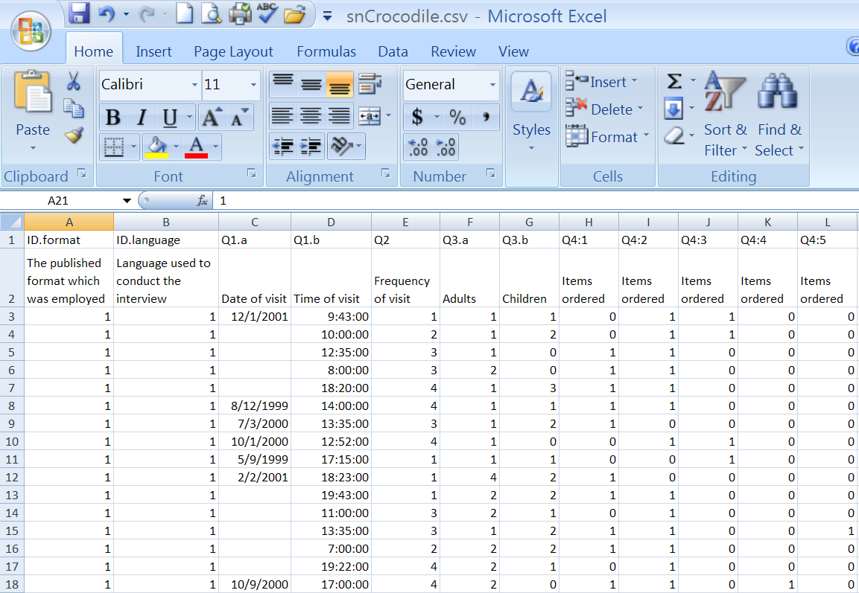
CSV Data File

Slide 10
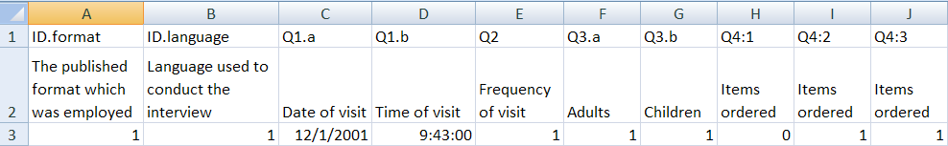
CSV Data File
Snap convention:
Q4:1 for Multiple Response and Grid categories
Q3.a for separate questions within a question and for “Other, please Specify”
It is your choice what to use.
The two rows for Variables Labels helps you check your own labels.

Slide 11
Getting Data Ready in XLDA
Steps:
In the CSV file block and copy all data.
In your XLDA Data Sheet: place the courser in cell A2 and paste.
Check that your XLDA Variable Labels (row 1) match the data structure from Snap (rows 2 & 3).
Edit your Variable Labels as needed.
Once everything is fixed, delete rows 2 & 3 with the Snap labels.
Data should now start in Row 2.
Delete rows with faulty and incomplete data.

Slide 12
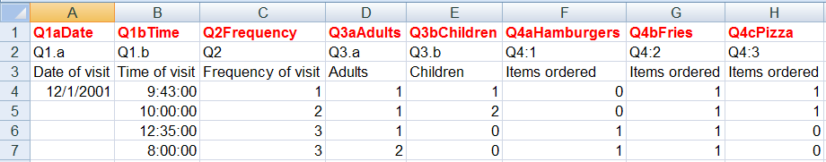
Copy from CSV to XLDA
In the CSV file block and copy all data.
In your XLDA Data Sheet: place the courser in cell A2 and paste.
Check that your XLDA Variable Labels (row 1) match the data structure from Snap (rows 2 & 3).
Edit your Variable Labels as needed.

Slide 13
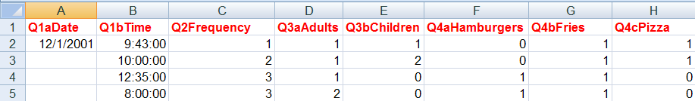
XLDA Data
Once everything is fixed, delete rows 2 & 3 with the Snap labels.
Data should now start in Row 2.
Delete rows with faulty and incomplete data.

Slide 14
XLDA Data
You are now ready to analyze the data using XLDA.

